Slide 1
Walsall Council Social Care and Inclusion
The Care Act 2014
What it will mean for you
Stuart Fletcher

Slide 2
The Care Act 2014
The Care Act has created a single law that makes it clear what kind of care people and their carers should expect. It replaces many previous laws

Slide 3
What is the Act trying to achieve?
Care and support will:
Be clearer and fairer
Improve people’s wellbeing
Wherever possible prevent and delay the need for extra care and support in the future.
Put people in control of their lives
Put carers on the same footing as those they care for.
Notes:
[Facilitators Note: This slide has animation. Each click brings in a different point for discussion]

Slide 4
Other features of the Act
The first legal framework for protecting adults from abuse and neglect
Social Care, Health and Housing agencies must work together
A duty to ensure that a wide range of care and support services are available
New protections to ensure that no one goes without care if their provider fails, regardless of who pays for their care
New legal right to a personal budget and direct payment

Slide 5
Deferred Payments
Ensures that those need Social Care and support and have assets do not need to sell their property immediately to pay for their care costs.
Securing a loan against the property and once the care costs have ceased the security can be used to pay off the loan.
Notes:
Rules around cohabitation

Slide 6
What does this mean for people needing care and support?
Better access to information and advice, preventative services, and assessment of needs
An entitlement to care and support
A cap on care expenditure
A common system across the country:

Slide 7
Personal dignity (including treatment of the individual with respect)
Physical and mental health and emotional wellbeing
Protection from abuse and neglect
Control by the individual over day-to-day life (including over care and support provided and the way it is provided)
Participation in work, education, training or recreation
Social and economic wellbeing
Domestic, family and personal relationships
Suitability of living accommodation
Individual’s contribution to society

Slide 8
Advice and information
Duty to provide people in the area with information and advice relating to care and support for adults and support for carers
Includes telling people where they can get independent financial advice about how to fund their care and support
New Duty to provide independent advocacy to help people to be involved in key processes, such as assessments, reviews and safeguarding enquiries

Slide 9
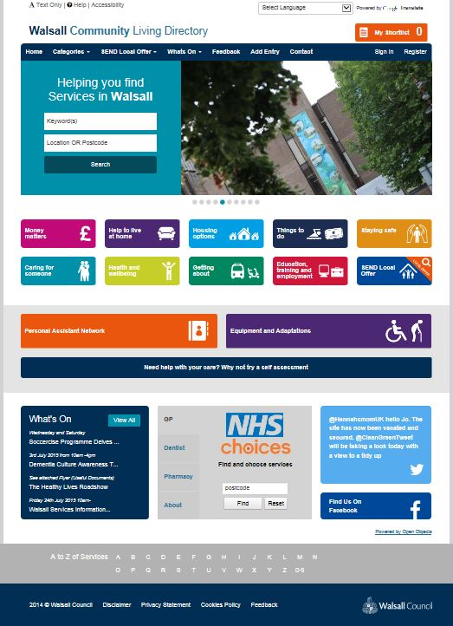
Walsall Community Living Directory

Slide 10
What is WCLD?
Walsall Community Living Directory (WCLD) is an online
directory of services the tool that offers greater choice and control for people who may need social care and health services.
The directory makes information about local services more
accessible and supports our duties regarding the Care Act.
Putting all the information about local services in one place
will make it easier for people to find information about the full
range of services and support available in the Walsall.
Notes:
This will benefit:
Staff from within directorate and across the council
External Providers, Third Sector, Community and Voluntary Organisations
Carers
Customers
Local Citizens

Slide 11
Web Link
www.wcld.co.uk

Slide 12
Walsall Council’s range of Preventative Services aims to:
Assess your individual needs.
Promote independence.
To enable and support people to regain confidence and skills to live at home.
Reduce Risks.
Establish a plan identifying outcomes or your goals.
Take steps to prevent, reduce or delay the need for care and support for all local people.

Slide 13
Assessment and eligibility
Anybody, including a carer, who appears to need care or support is entitled to an assessment and the assessment must focus on outcomes important to the individual.

Slide 14
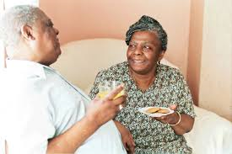
What does this mean for carers?
The Care Act strengthens the rights and recognition of carers:
Improved access to information and advocacy should make it easier for carers to access support and plan for their future needs
The emphasis on prevention will mean that carers should receive support early on and before reaching crisis point
Adults and carers have the same rights to an assessment on the appearance of needs
A local authority must meet eligible needs based on needs that arise as a consequence of providing ‘necessary care’ to an adult and to then prepare a support plan subject to review.
A carer should be kept informed of the care and support plan of the person they care for.
Notes:
[Facilitators Note: This slide has animation. The first bullet point appears when the slide opens and then the next click brings in the secondary bullet points that explain it further, and the next click shows the last bullet point about the Children and Families Act]

Slide 15
The Carer Aware Course can be located on the Council Website on http://cms.walsall.gov.uk/index/carer_aware_training.htm
However, this is the Direct Link onto the e-learning course. http://www2.walsall.gov.uk/careaware2/launch_nolms.htm
It’s easy to navigate and use and contains lots of useful information for Carers.

Slide 16
A significant piece of legislation that modernises the framework of care and support law, bringing in:
New duties for local authorities
New rights for service users and carers
It aims to make care and support clearer and fairer and to put people’s wellbeing at the centre of decisions, and embed and extend personalisation
Local authorities have new responsibilities towards all local people, including self funders
There are significant changes to the way that people will access the care and support system

Slide 18
Carer Aware/Other sites
The Carer Aware Course can be located on the Council Website on http://cms.walsall.gov.uk/index/carer_aware_training.htm
It’s easy to navigate and use and contains lots of useful information for Carers.
Short video by Social Care Institute for Excellence
http://www.scie.org.uk/care-act-2014/
www.wcld.co.uk

